Slide 1
A PrestaShop Issue: Attacks and Defenses
INSE - 6140
Group- WCS
Pierre Watine (40027675)
Anik Chowdhury (40275019)
Akash Saha (40233587)

Slide 2
Prestashop for Vulnerability Analysis
Open-Source Platform: Enables easy vulnerability checks by researchers and developers.
Wide Usage: Protects a large user base through targeted security analysis.
E-commerce Security: Addresses unique challenges like payment security and data protection.

Slide 3
Key Features of PrestaShop: Front Office vs. Back Office
Front Office (Customer-facing)
User-Friendly Design: Intuitive, customizable, and mobile-responsive shopping interface.
Customer Accounts: Personal accounts for order tracking and customer services.
Back Office (Administration)
Comprehensive Dashboard: Central hub for inventory, statistics, and management tools.
Security Management: Robust security with permissions, audit logs, and access control.

Slide 4
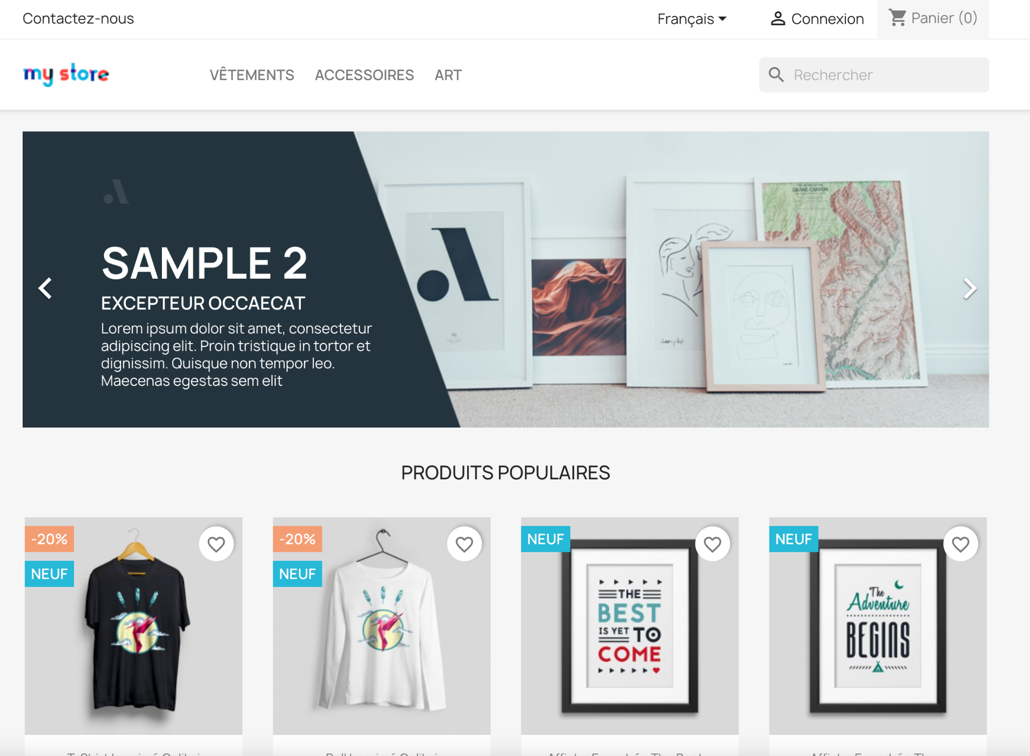
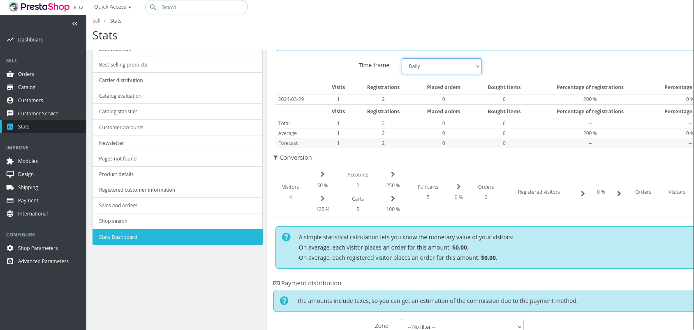
Front office and back office after Installation
We have installed Prestashop on 2 platforms. On local installation and docker installation.

Slide 5
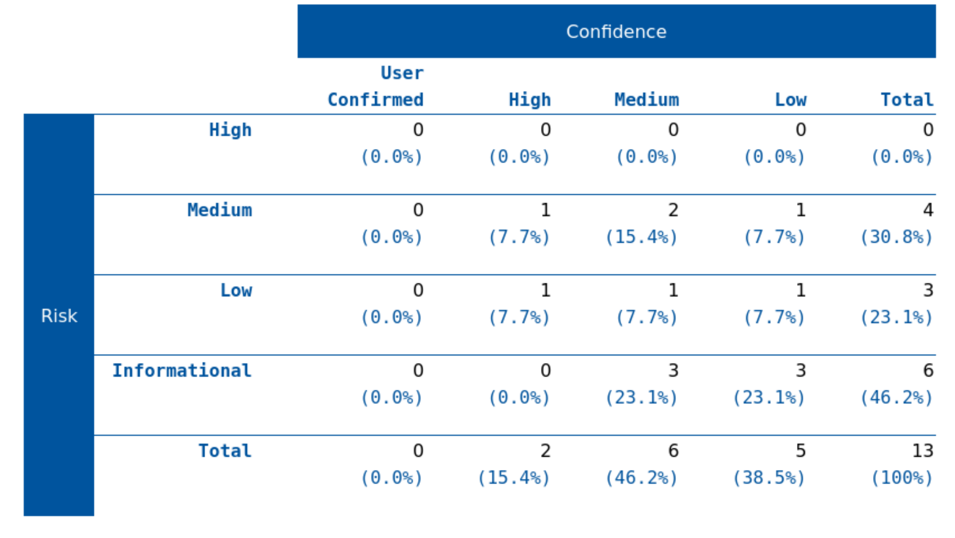
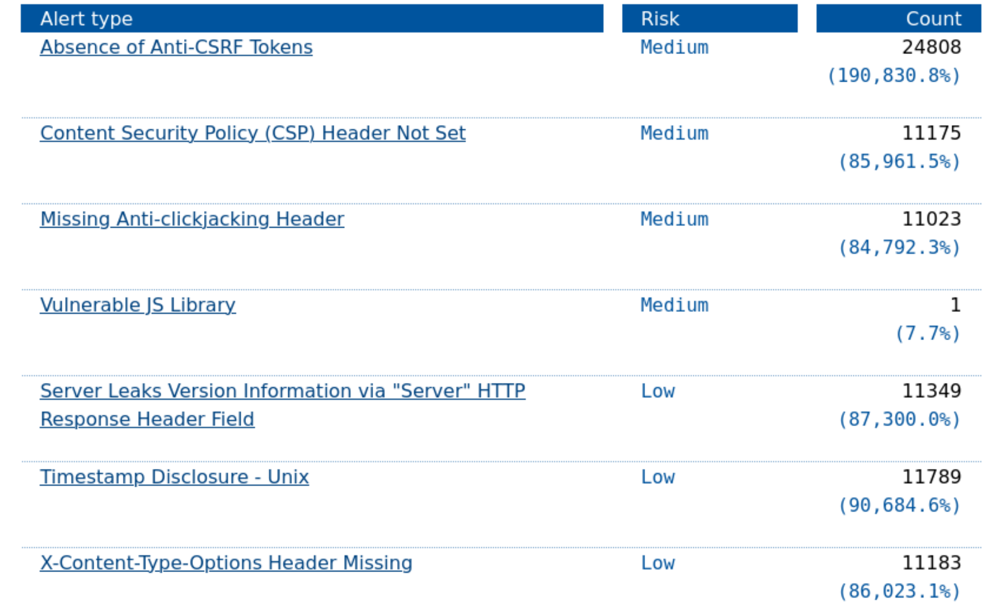
Dynamic Analysis (OWASP-Zap)

Slide 6
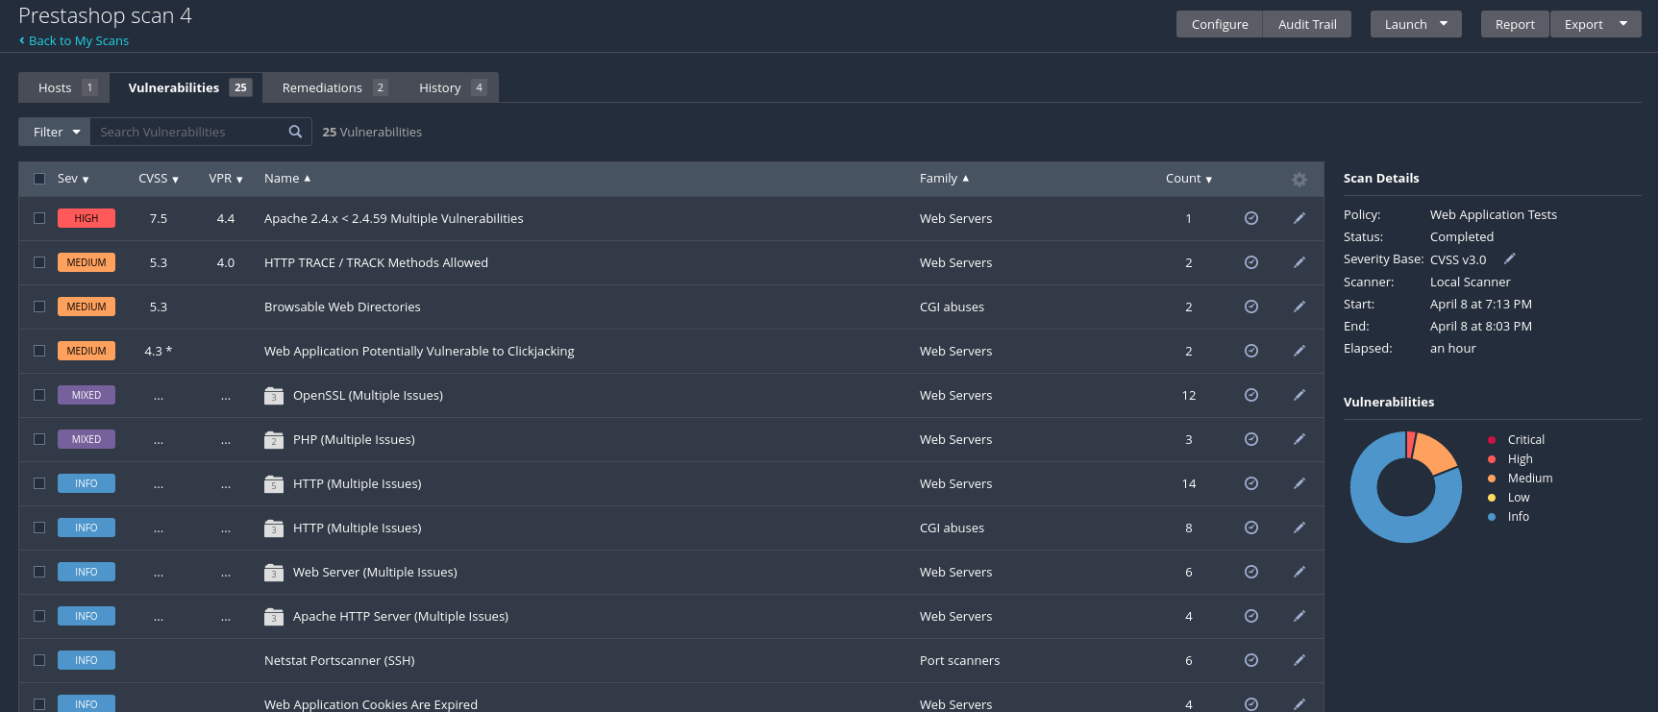
Dynamic Analysis (Nessus)

Slide 7
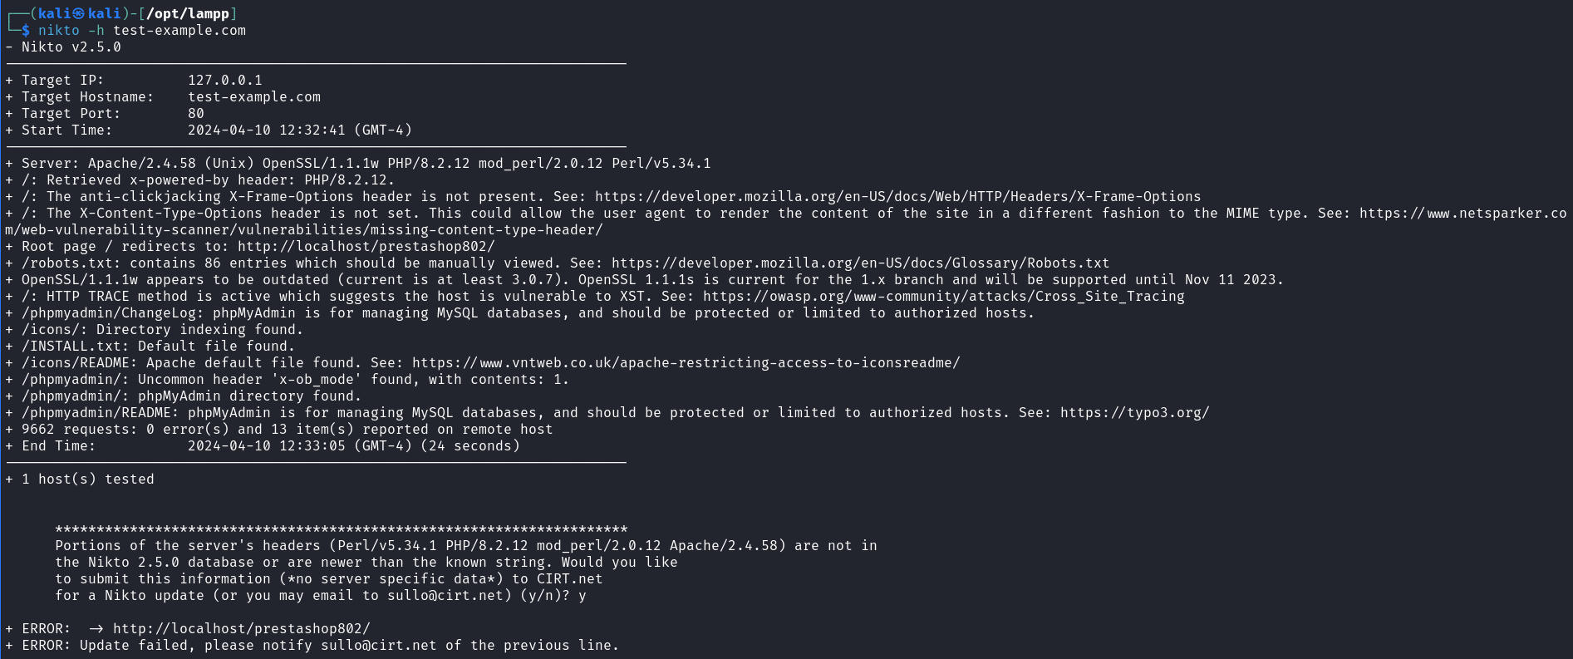
Dynamic Analysis (Nikto)

Slide 8
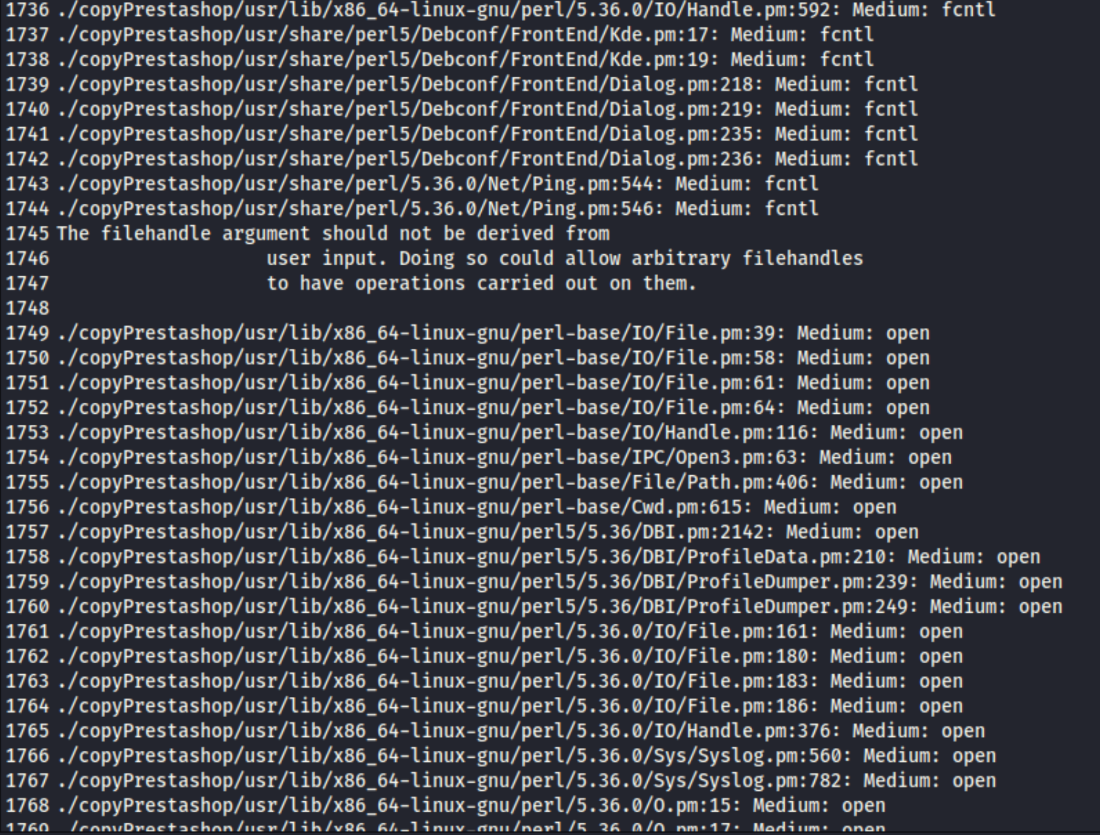
Source code analysis (RATS)

Slide 9
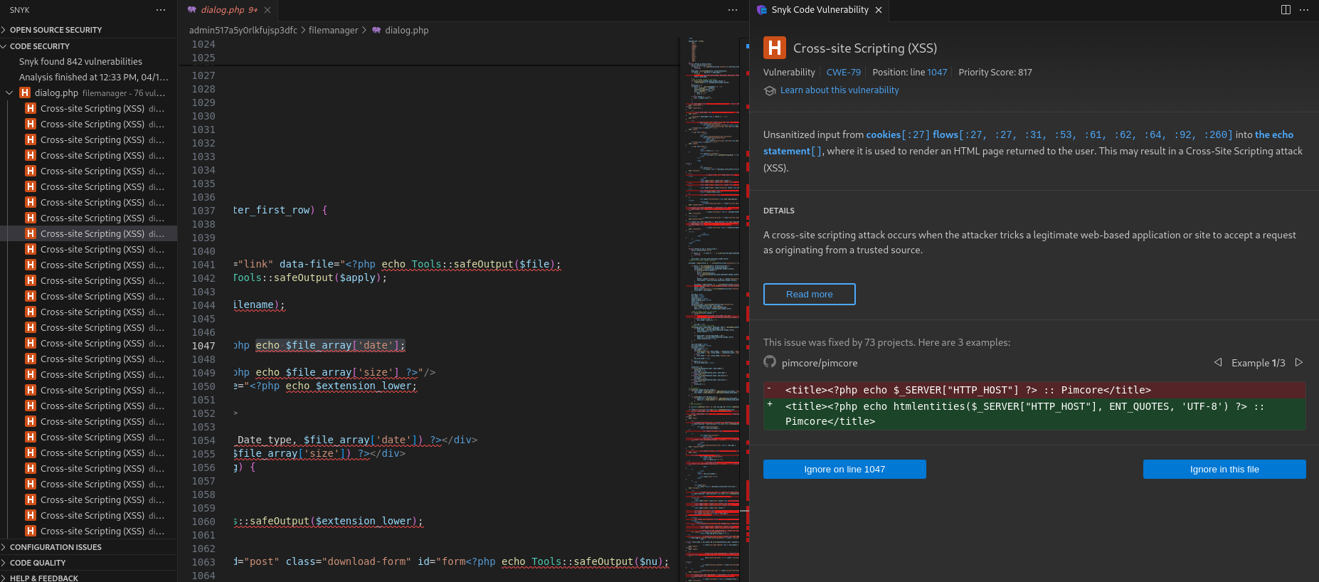
Source code analysis (SNYK)

Slide 10
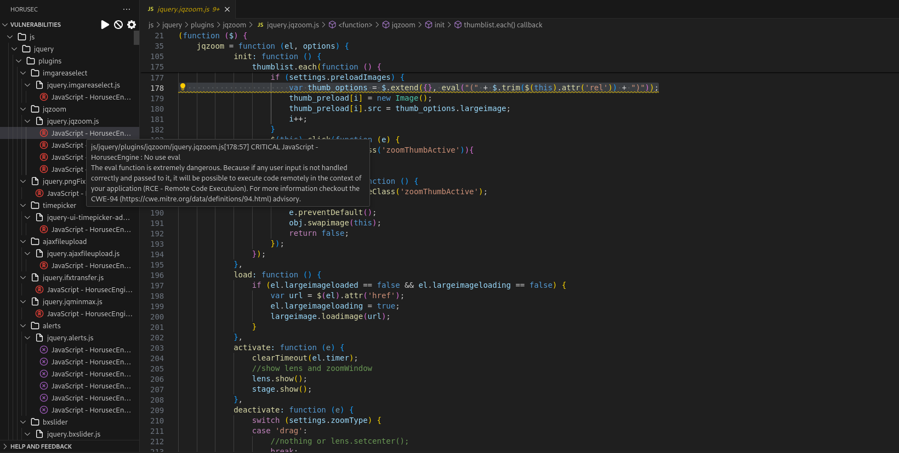
Source code analysis (HORUSEC)

Slide 11
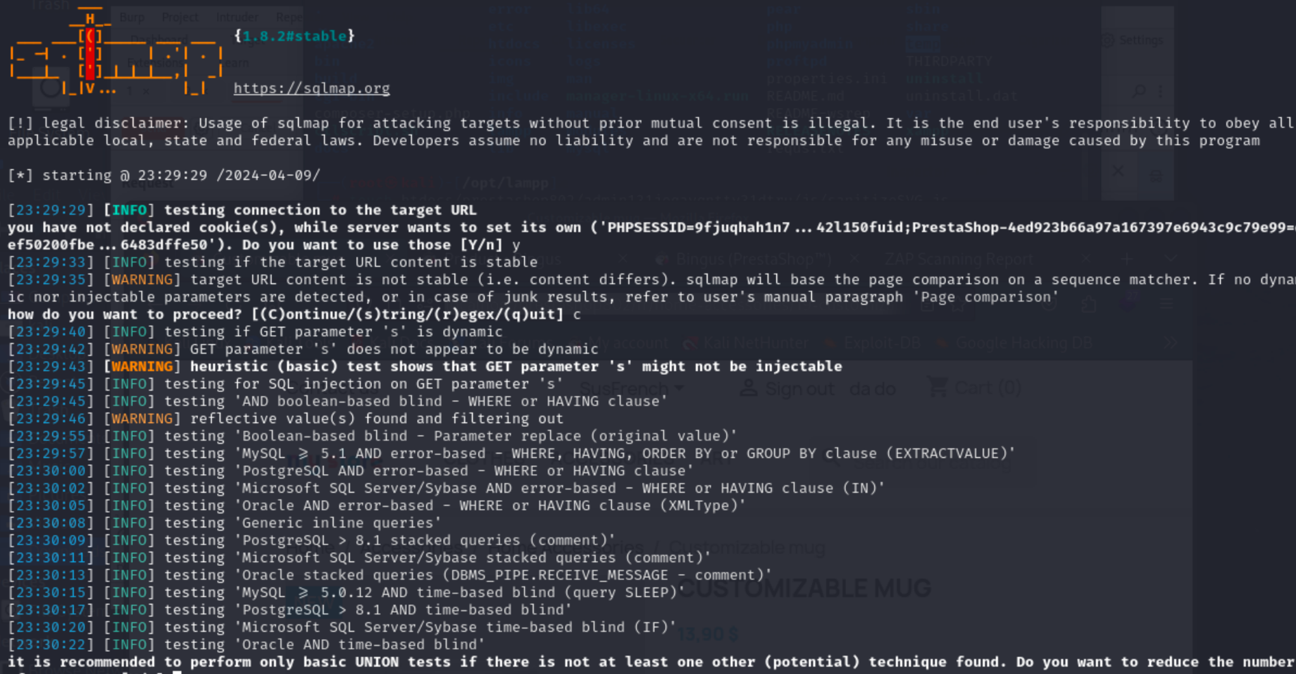
Other tools (SQLmap)

Slide 12
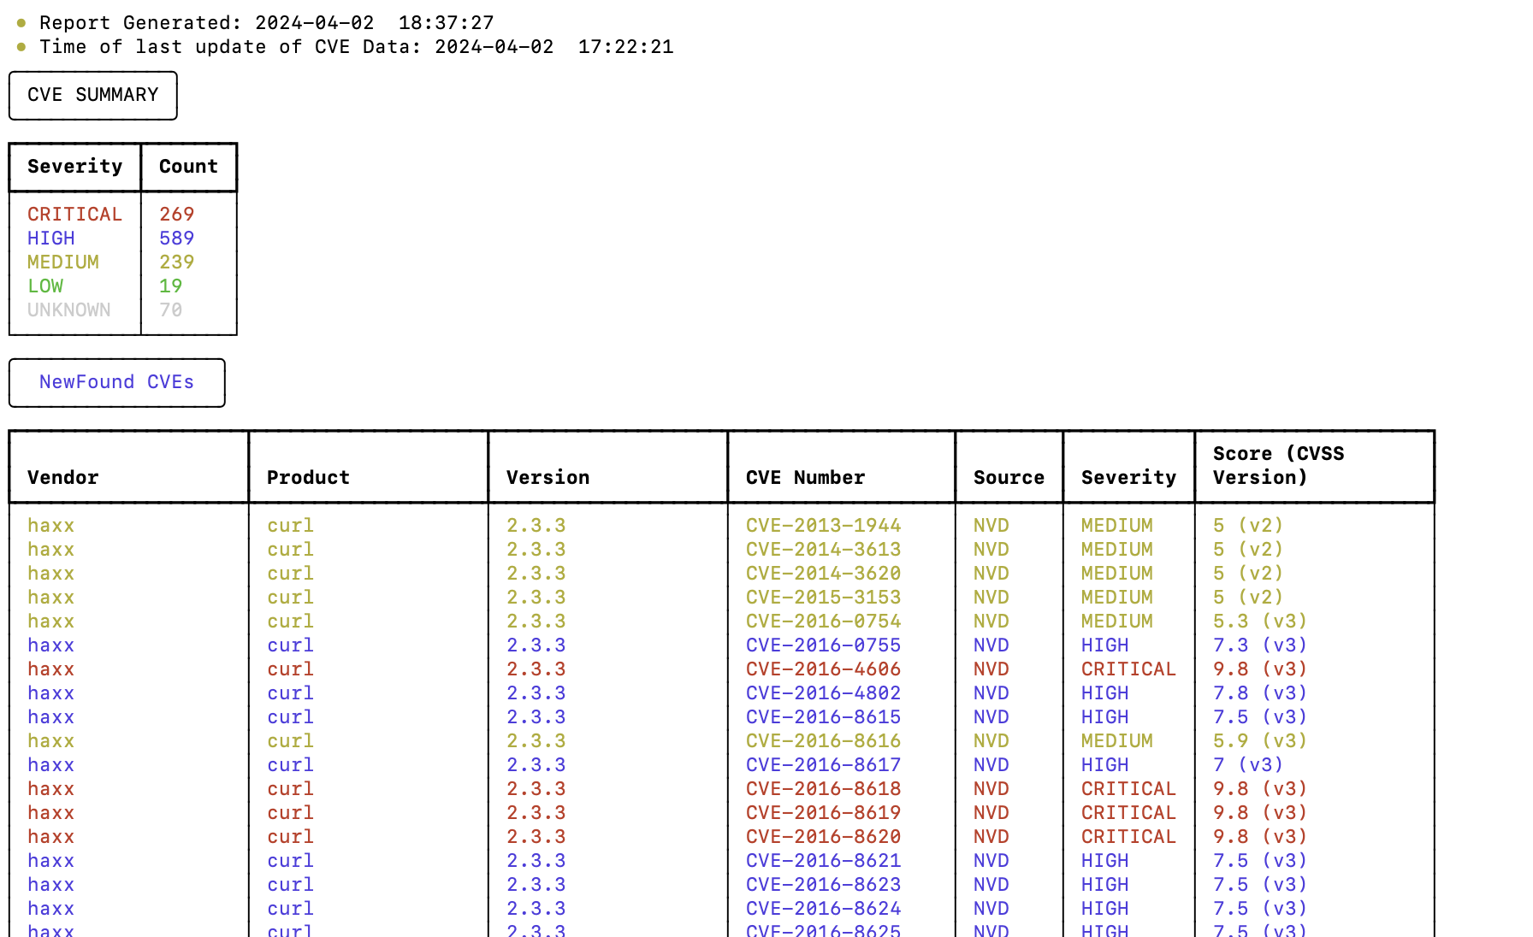
Other tools (CVE-bintool)

Slide 13
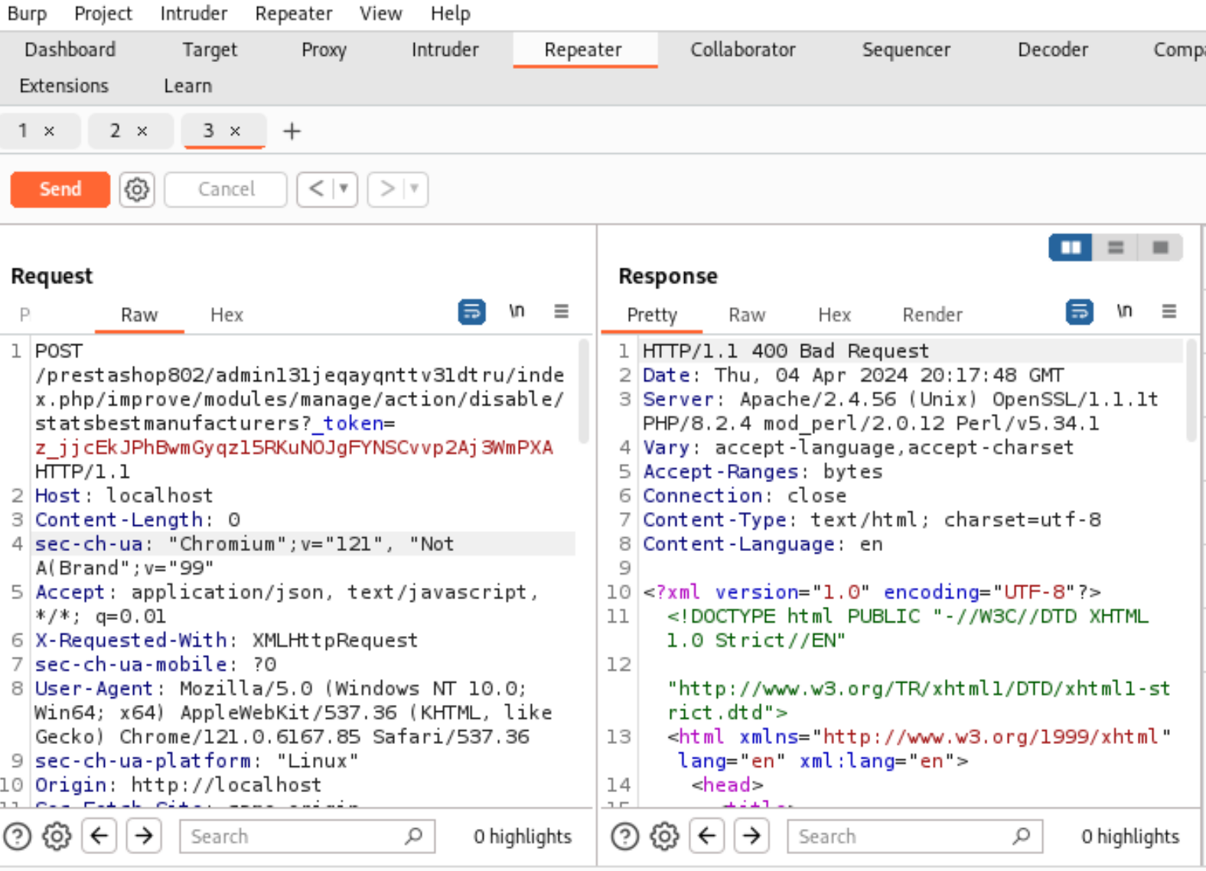
Other tools (Burp suite)

Slide 14



…and databases

Slide 15
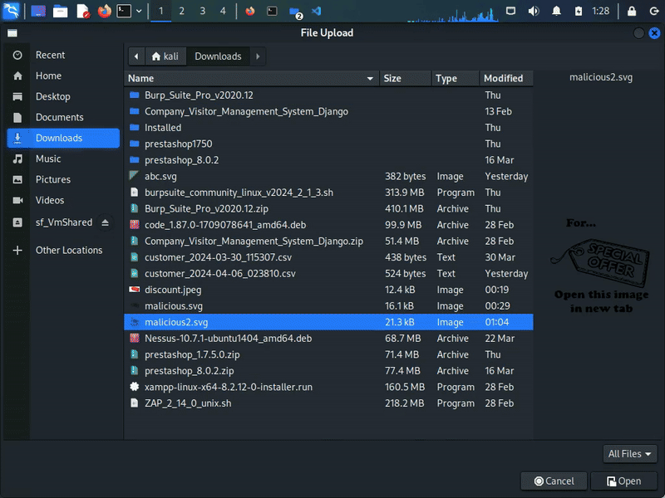
XSS Exploit through SVG

Slide 16
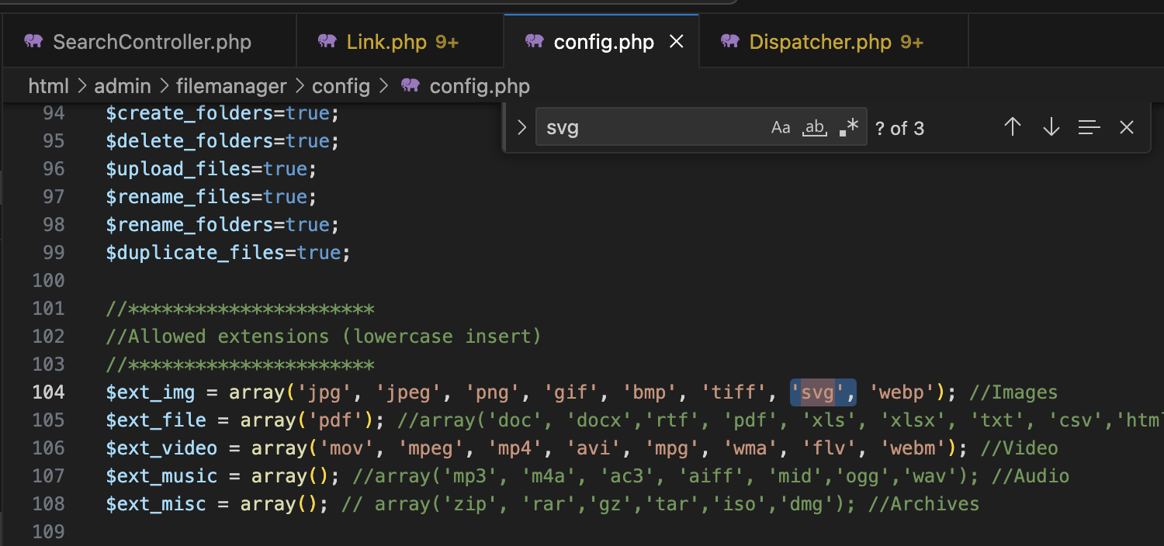
Solution 1: Stop the SVG uploads

Slide 17
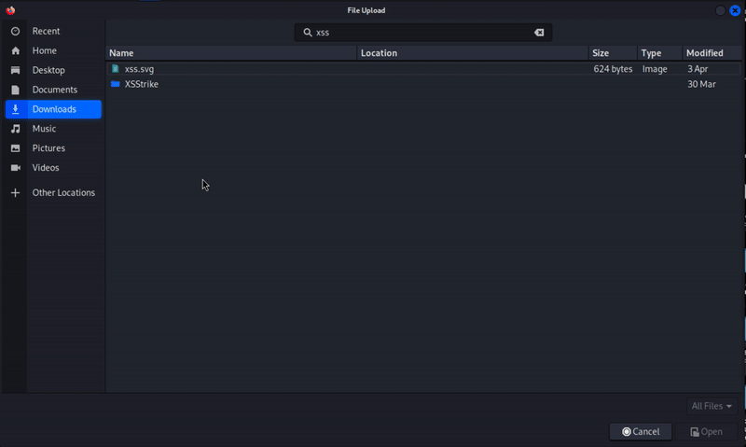

Slide 18
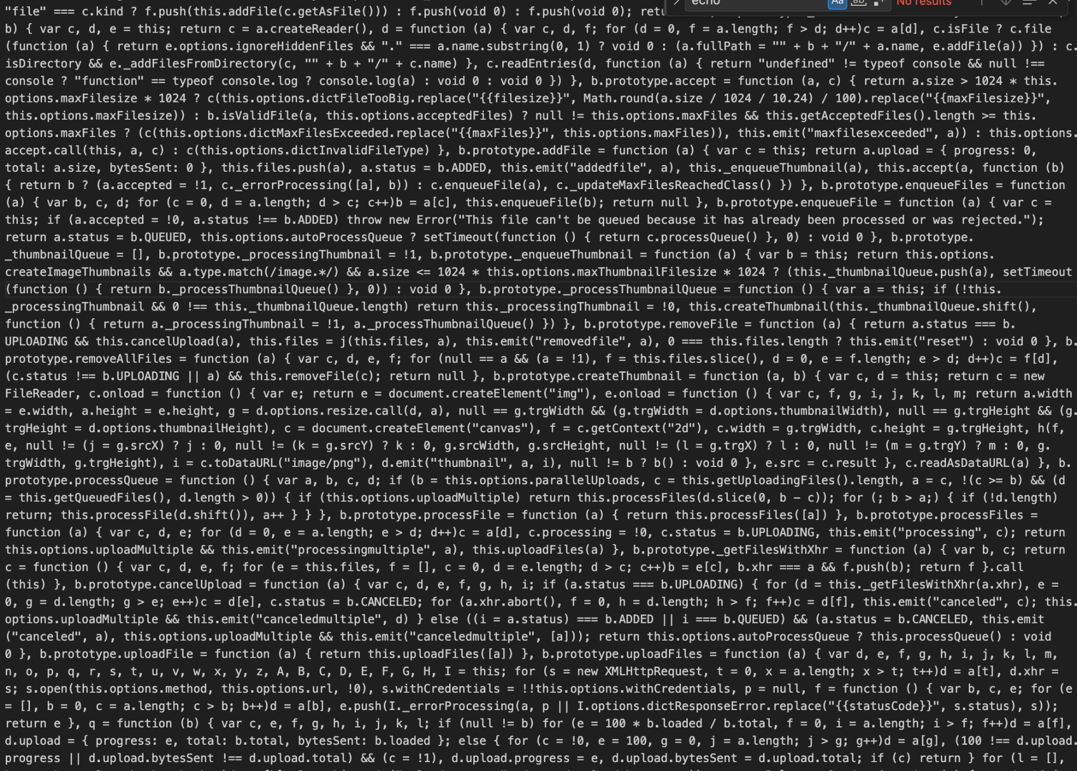


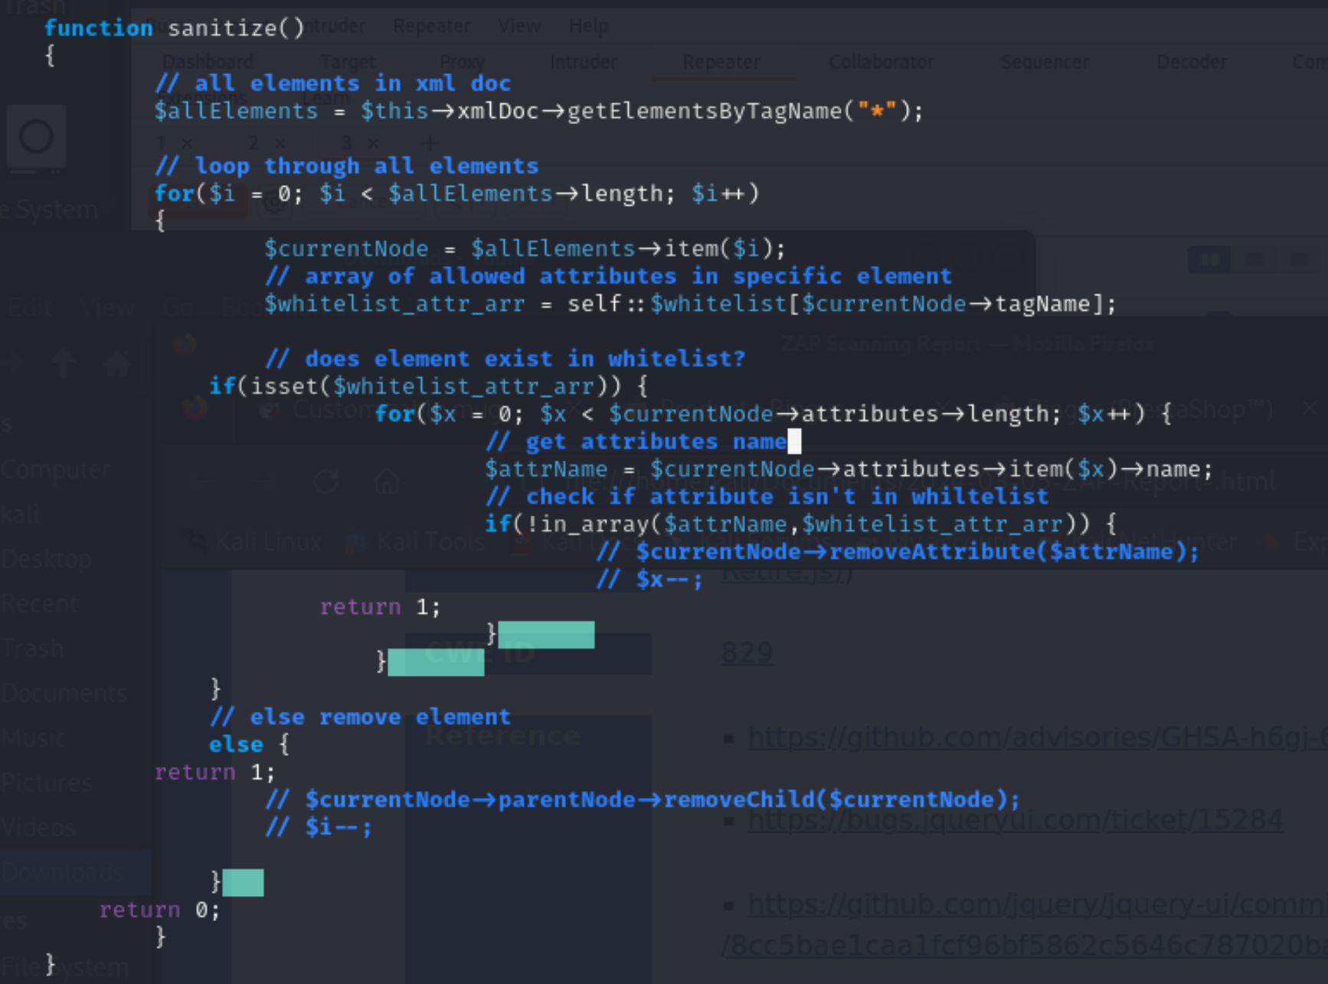
Solution 2: Sanitize the SVG
Get PHP script from https://github.com/alnorris/SVG-Sanitizer/tree/master
Sanitization
Sanitization
Sanitization
dialog.php
dropzone.min.js
uploader.php

Slide 19
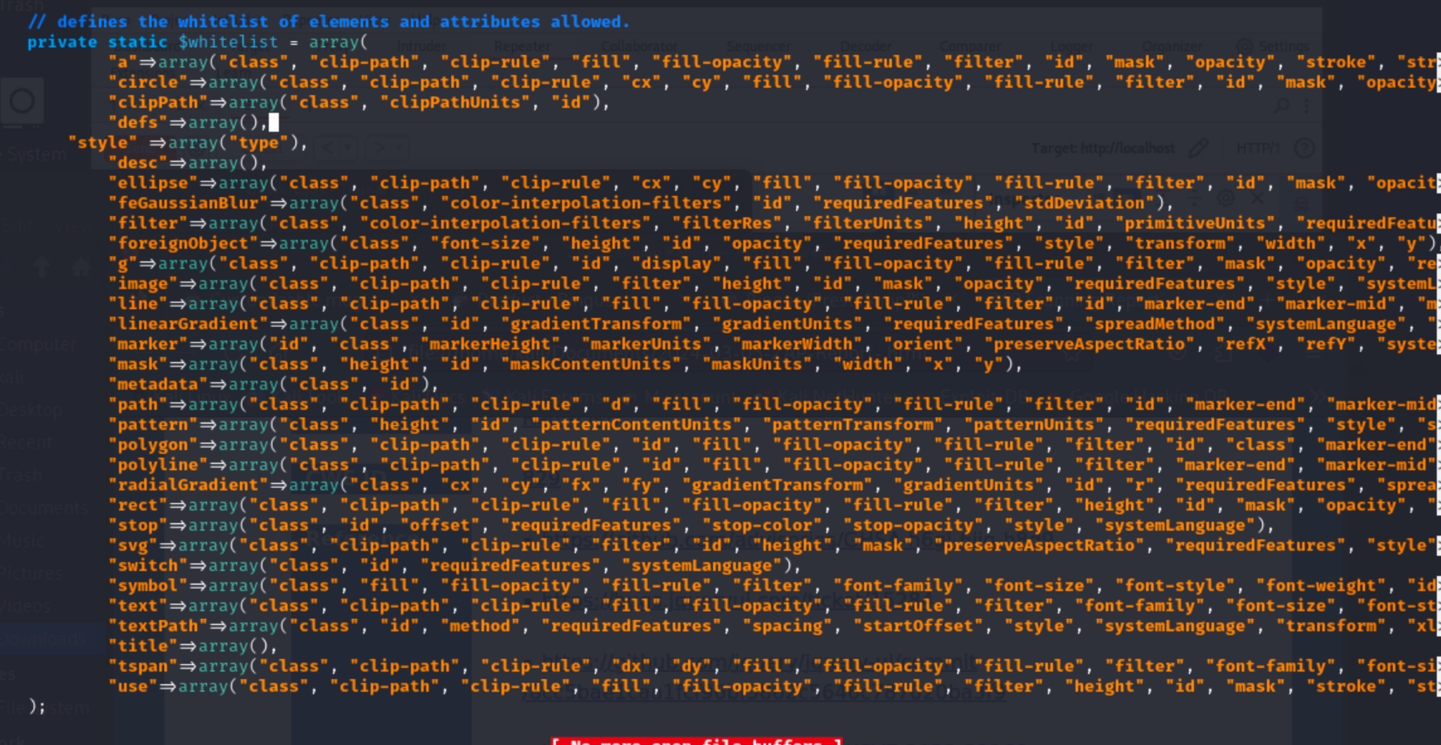
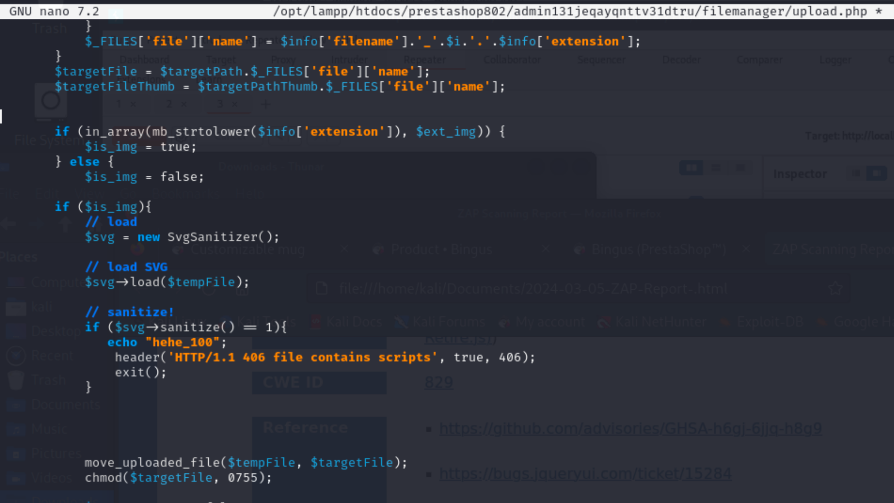
Implementation

Slide 20
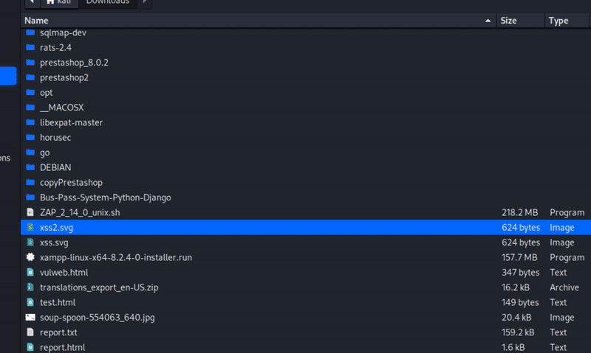
Results

Slide 21
Challenges
Setting up PrestaShop in a safe environment
Make the PrestaShop files available
Finding the vulnerabilities
Debugging for the defenses
Doing all that on a fairly recent version

Slide 22
Conclusion
Learned new tools
Learned different ways to implement XSS with measures in place
Learned tips on how to defend
Learned to “follow the information” to analyze how PrestaShop works
Learn to apply the material from the class to a real-life scenario

Slide 23
Thanks for watching!

